Slide 1
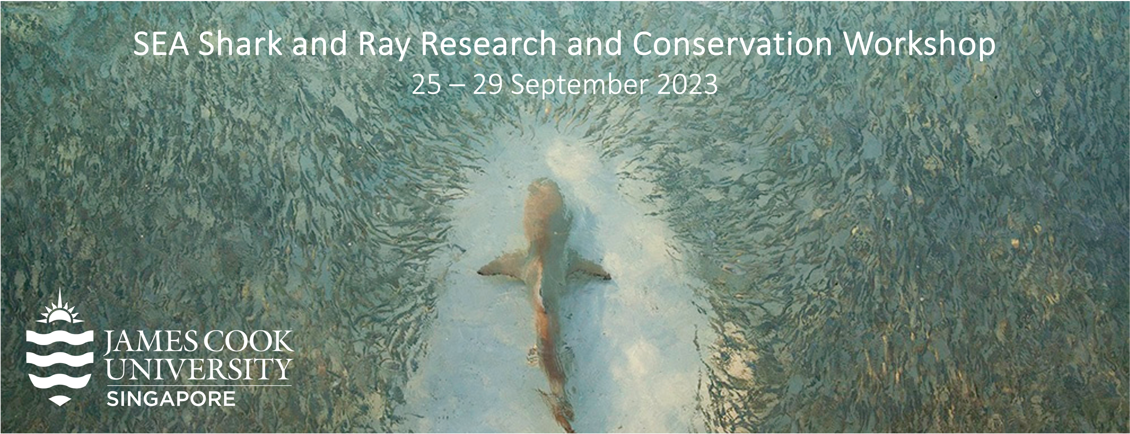
Analysing Telemetry Data with R

Slide 2

Survey Results
https://www.surveymonkey.com/stories/SM-FsIRC7dKSXIK0vmuulm6Vw_3D_3D/

Slide 3
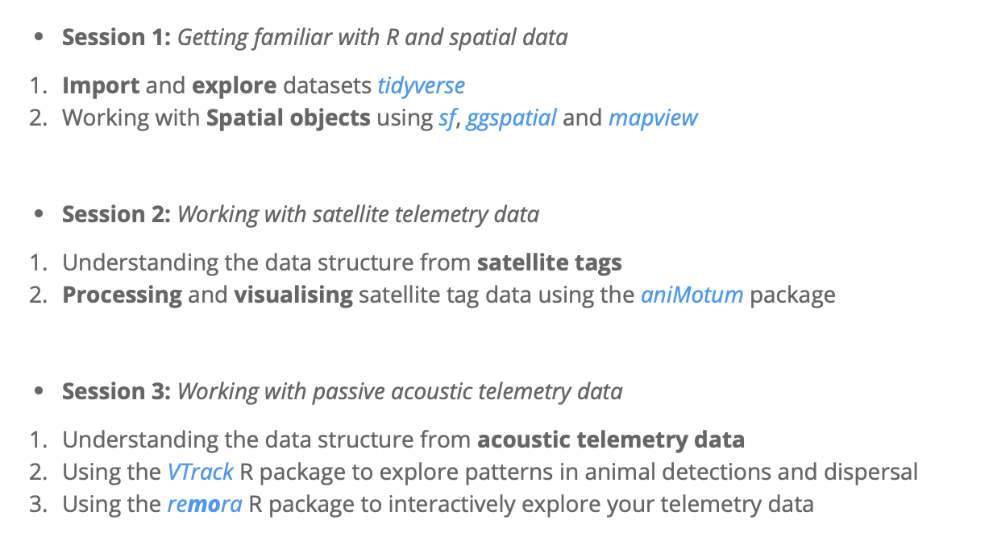
Program for today

Slide 4
Session 1

Slide 5
Session 2

Slide 6
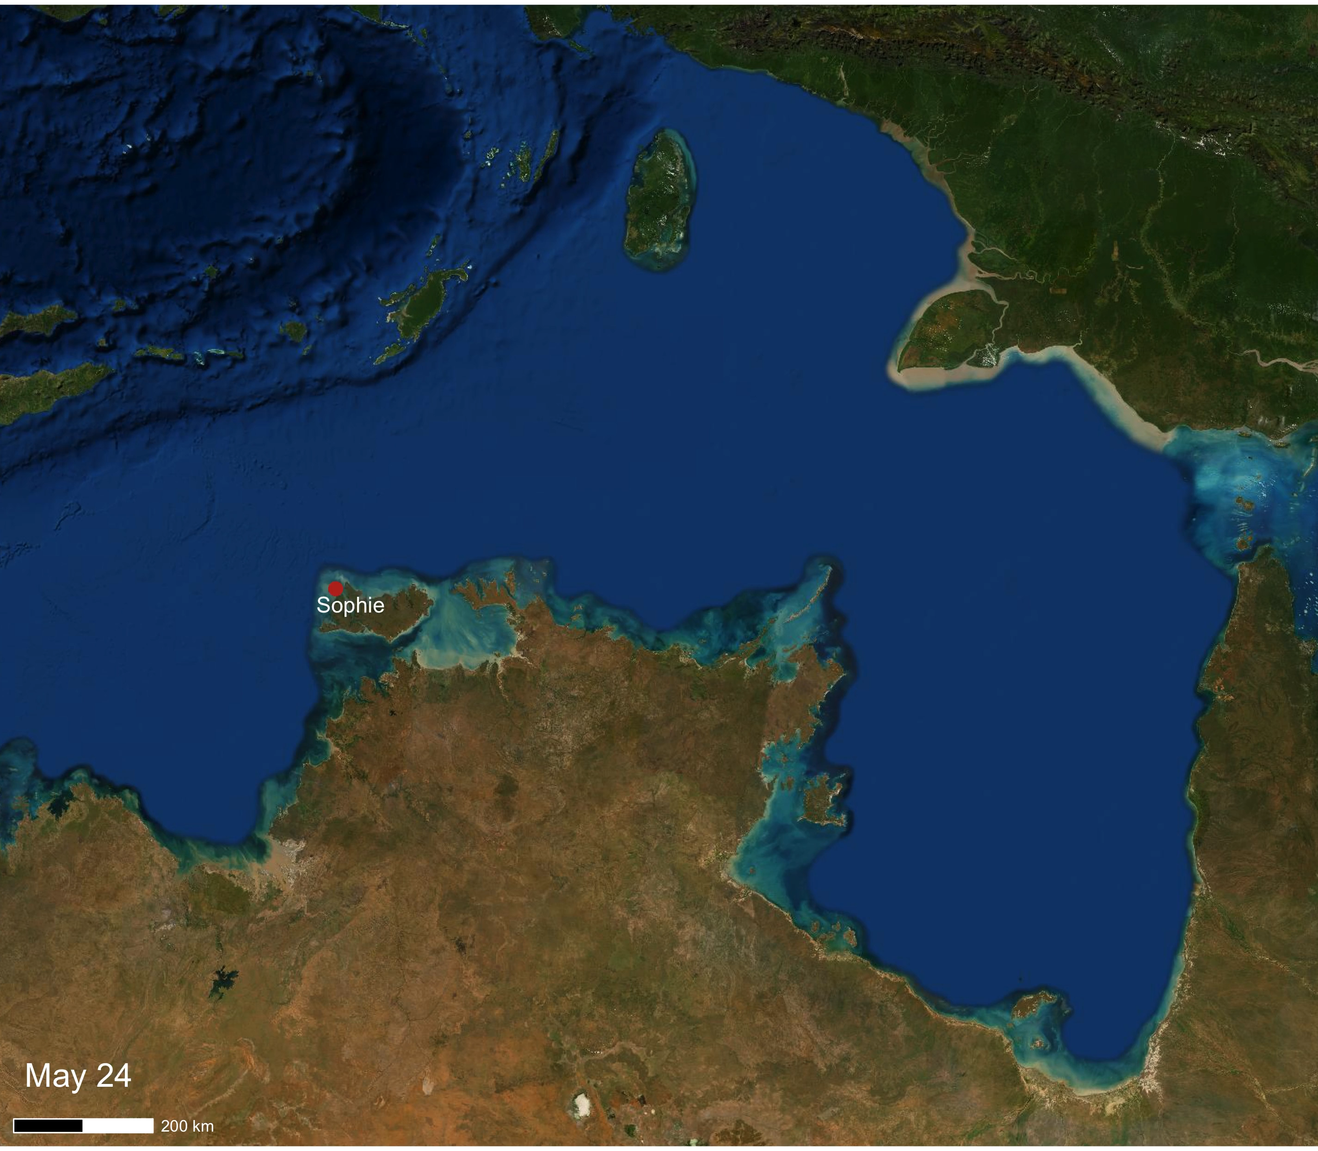
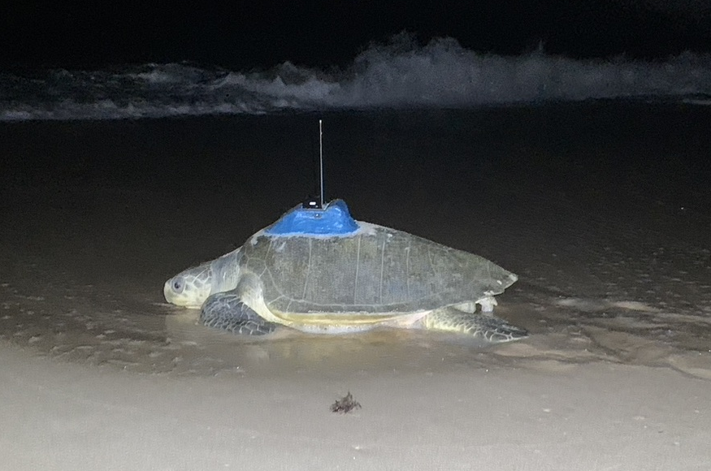
Session 2: Additional Steps
Animating tracks using GGANIMATE
Using the same GGSpatial framework to build your map
Use transition() functions

Slide 7
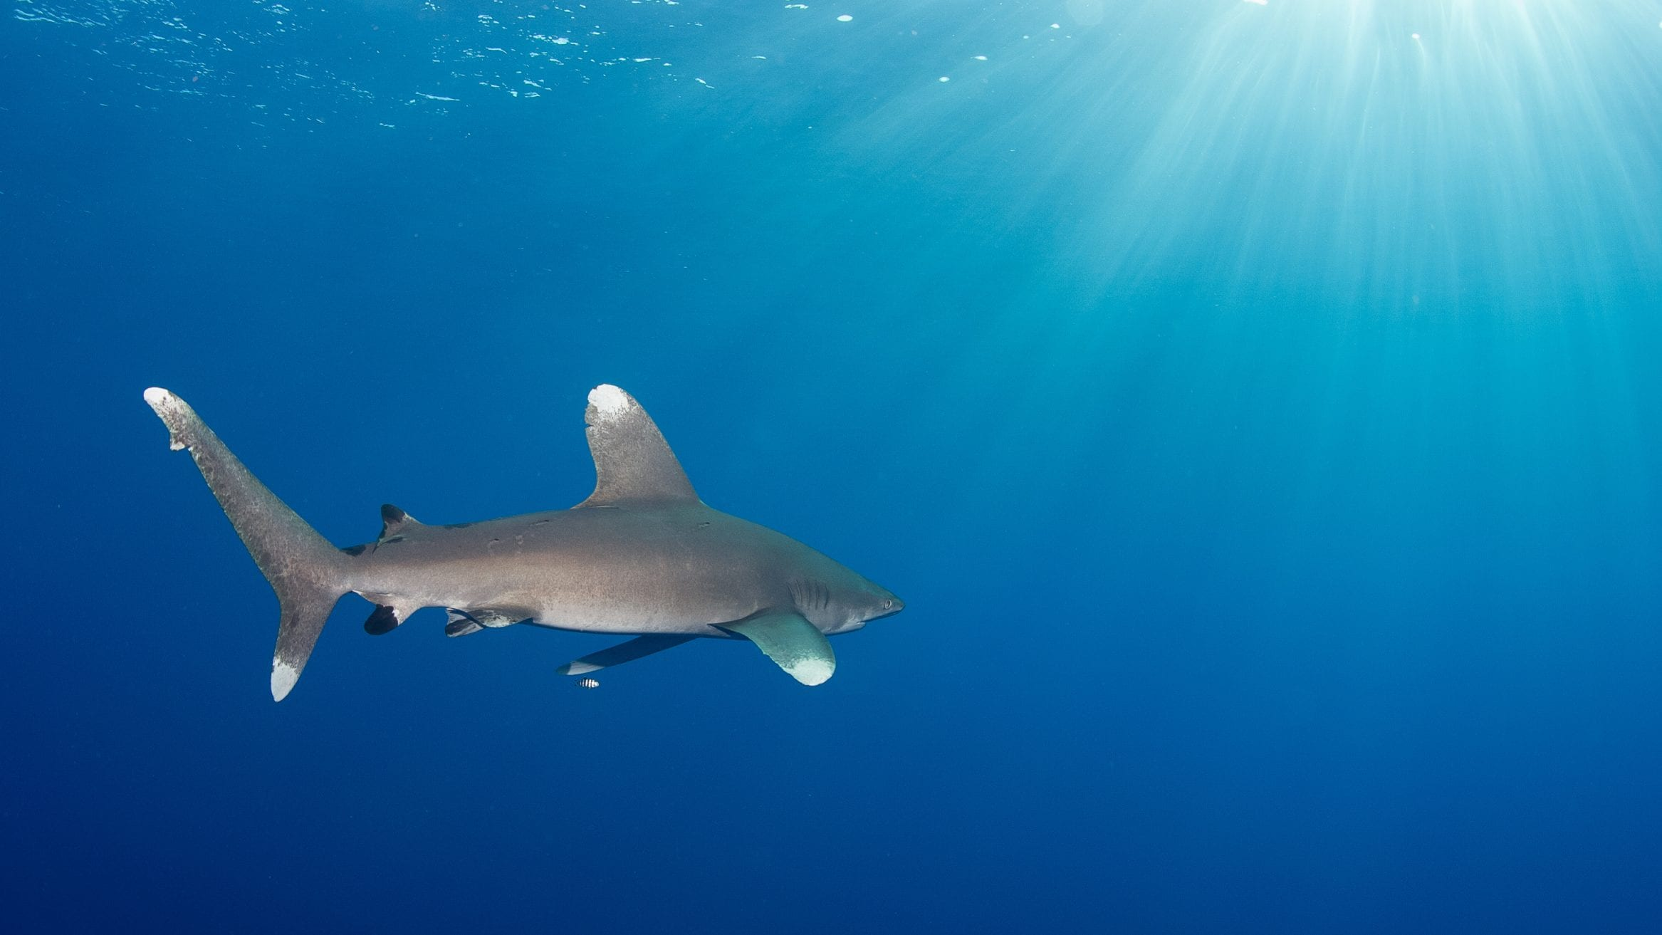
Session 2: Additional Steps
You can then add more layers to build on the complexity of the animation
For example: adding Location error polygons

Slide 8
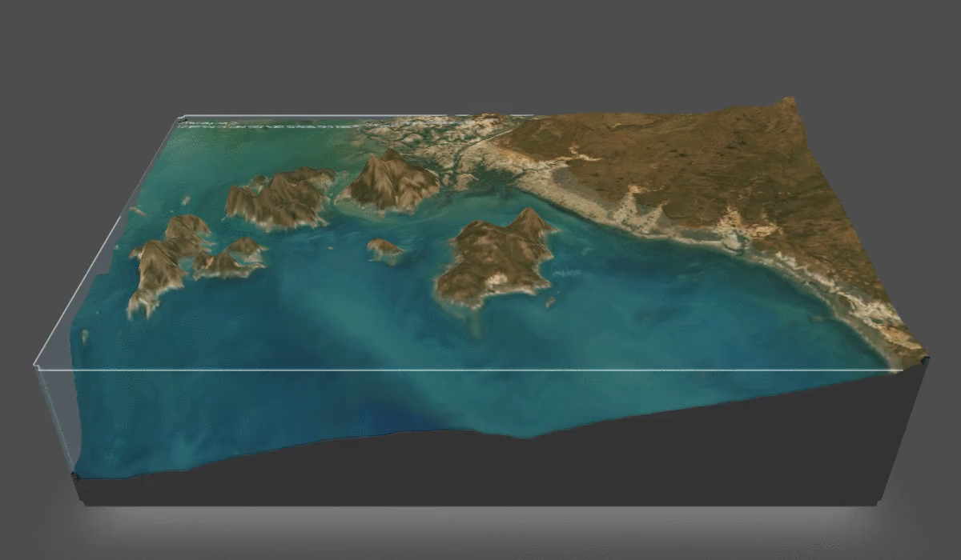
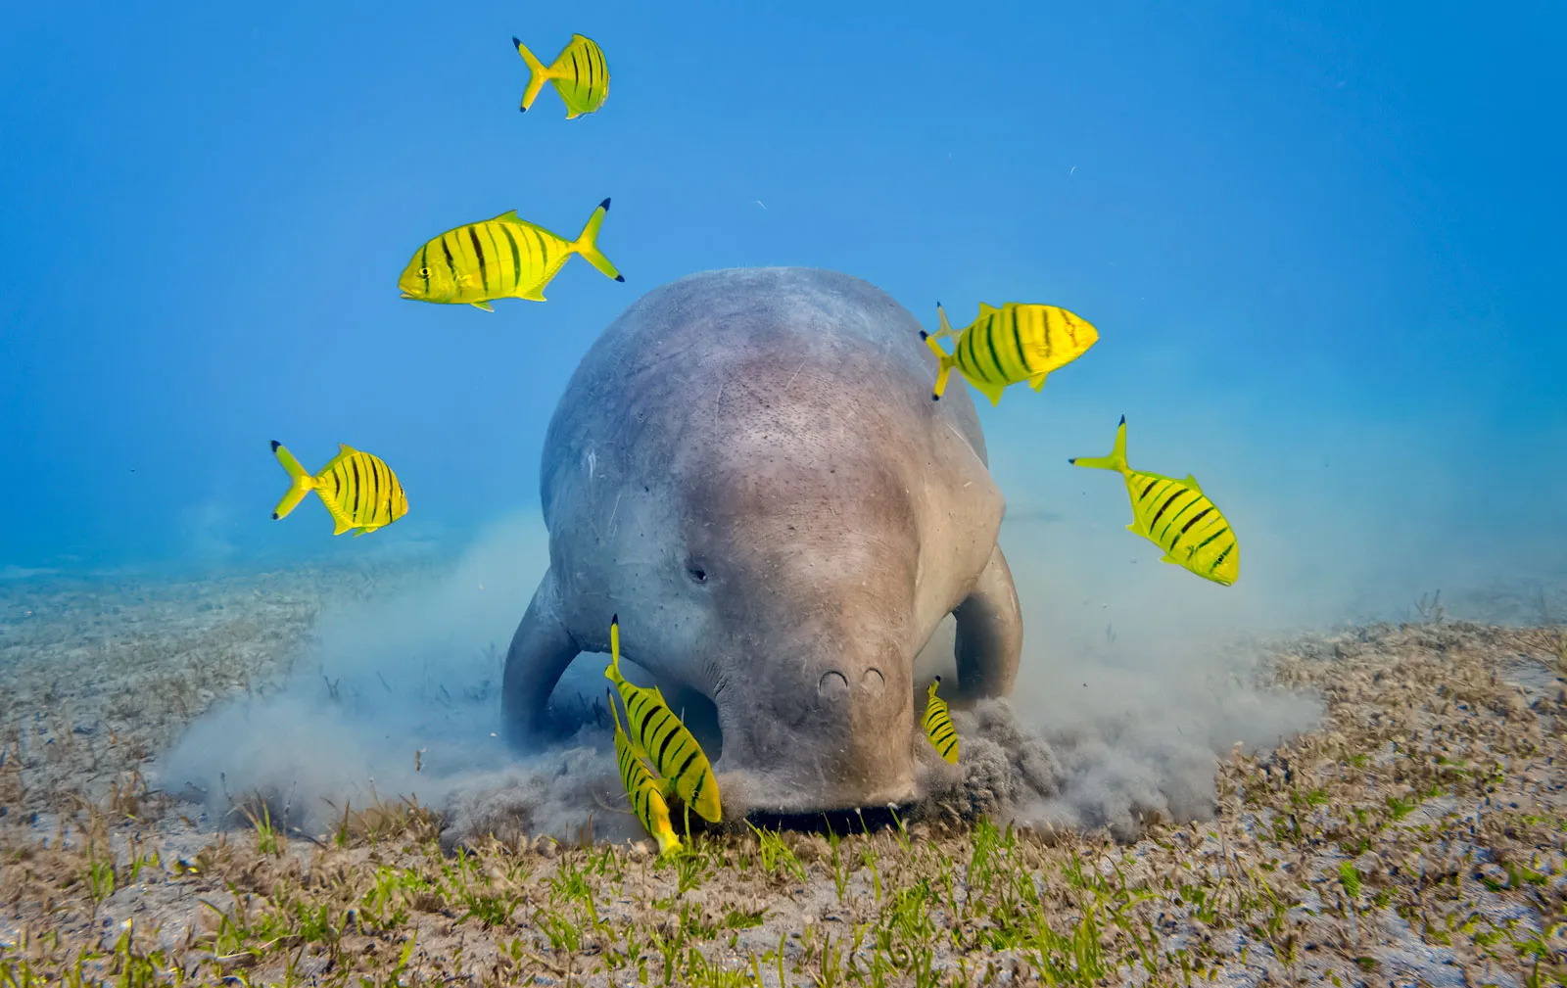
Session 2: Additional Steps
Integrating Depth data to plot your tracks in 3D
`KUD3D` and `rayshader` packages

Slide 9
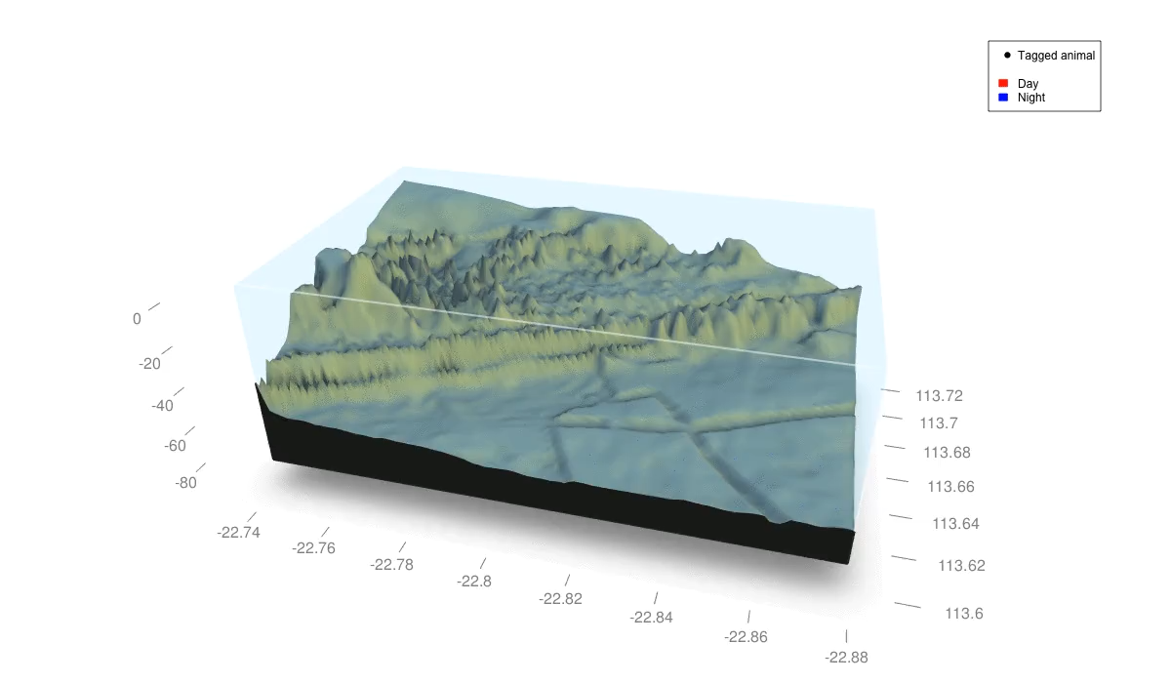
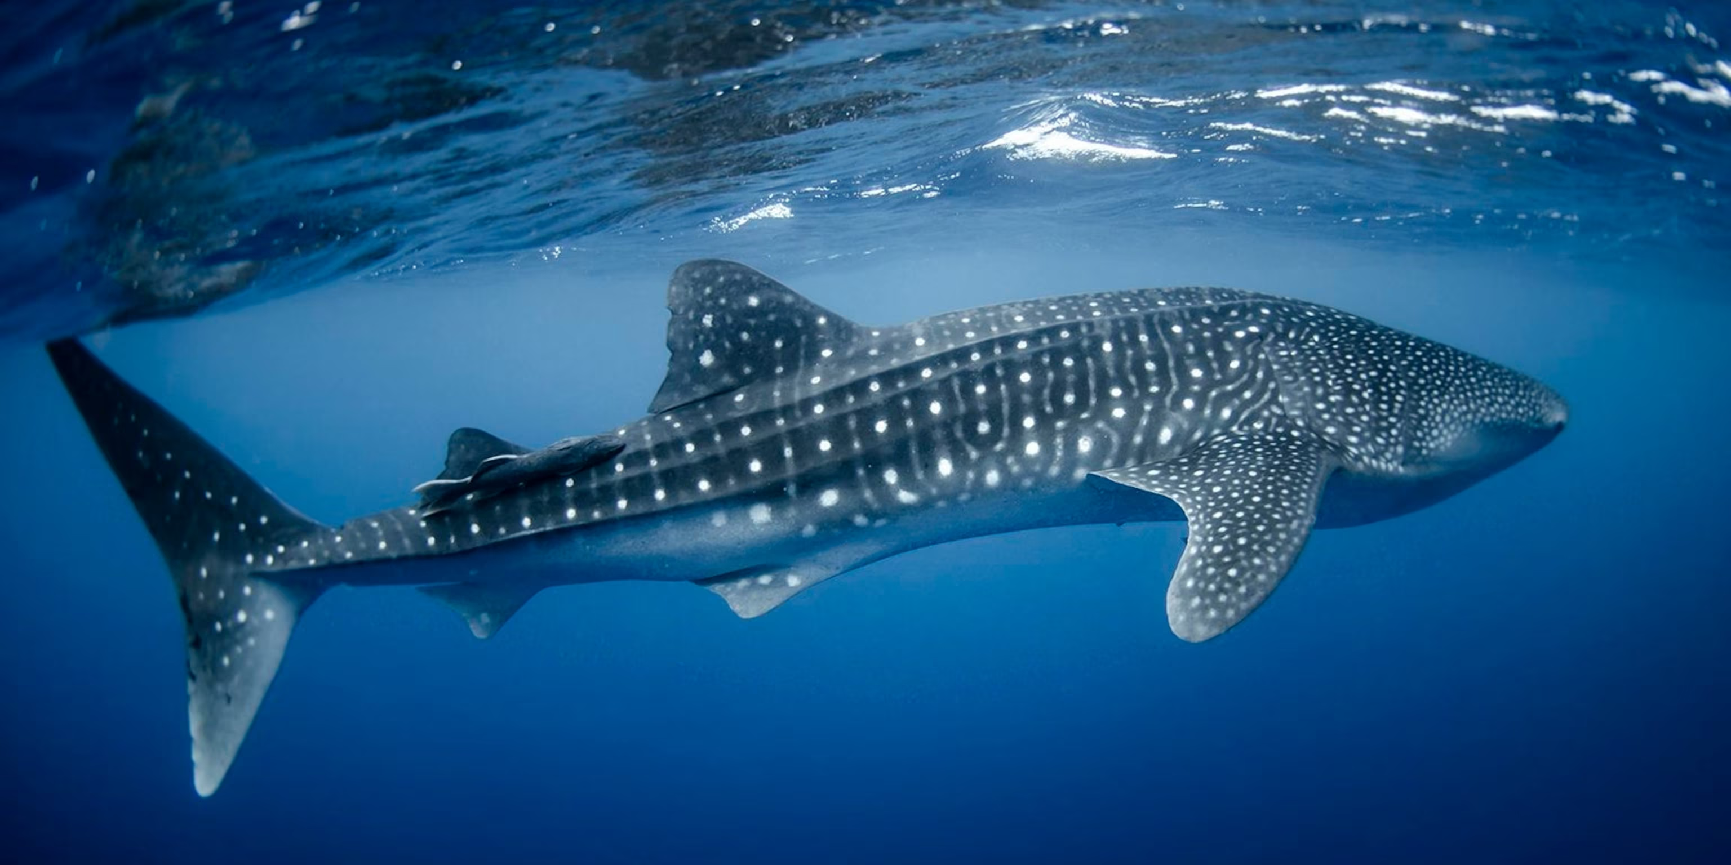
Session 2: Additional Steps
Integrating Depth data to plot your tracks in 3D
`KUD3D` and `rayshader` packages
Calculate and visualise 3D activity spaces

Slide 10
Session 3

Slide 11


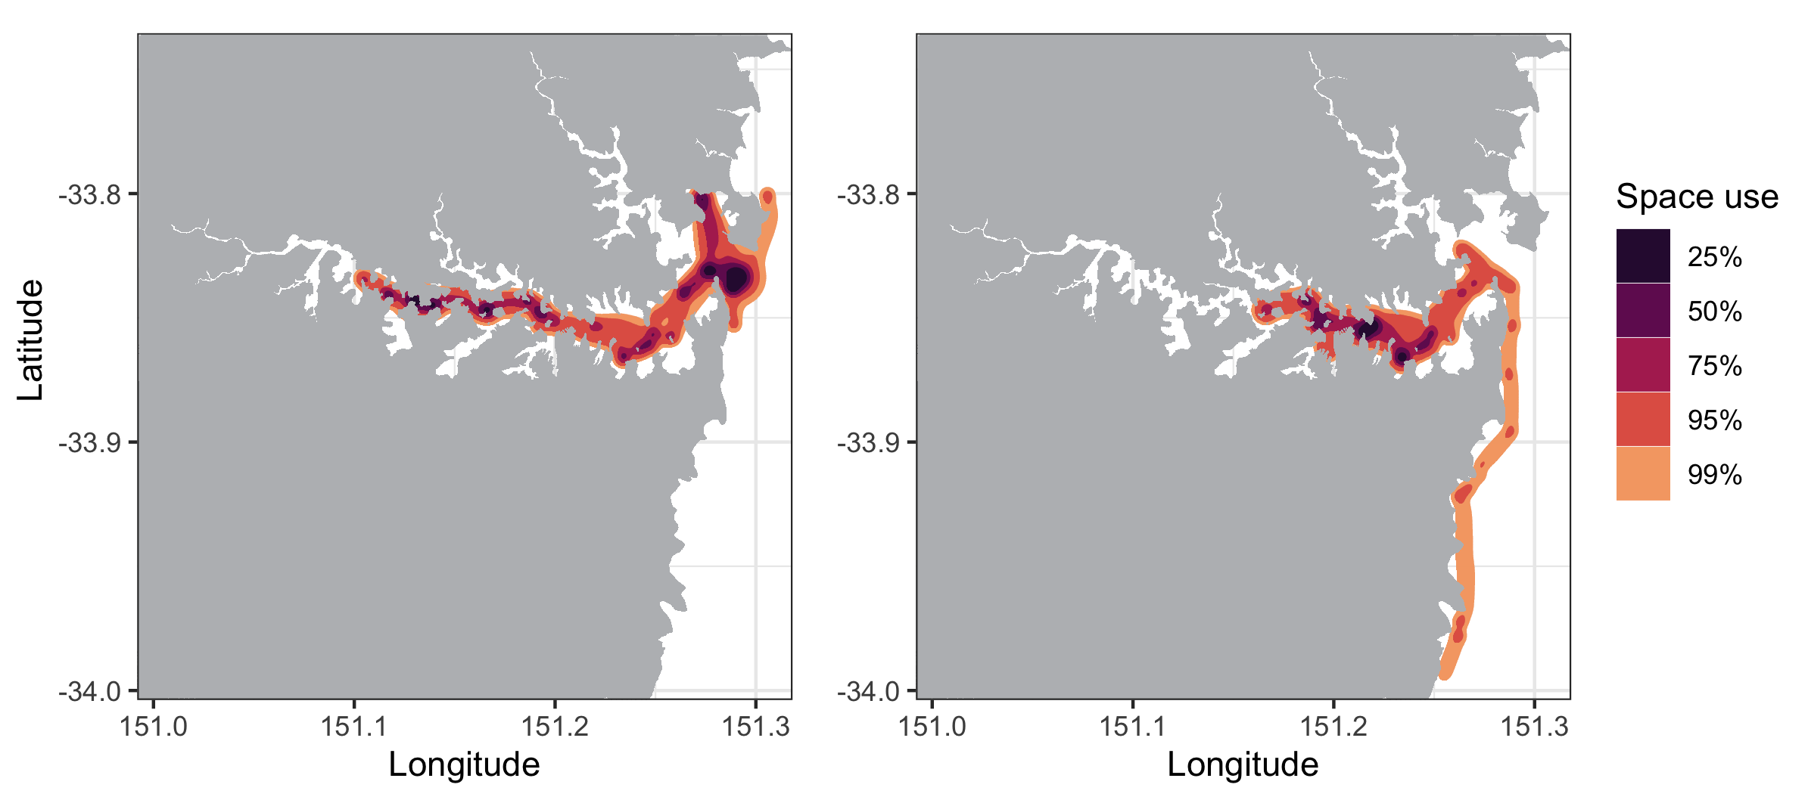
Session 3: Additional Steps
https://imos-animaltracking.github.io/Innovasea-IMOS-Workshop-2022/index.html
Integrating least cost paths into your Acoustic tracks
RSP package

Slide 12

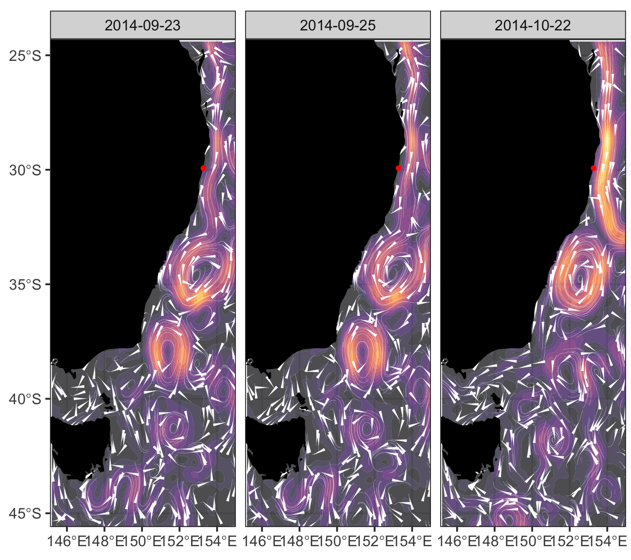
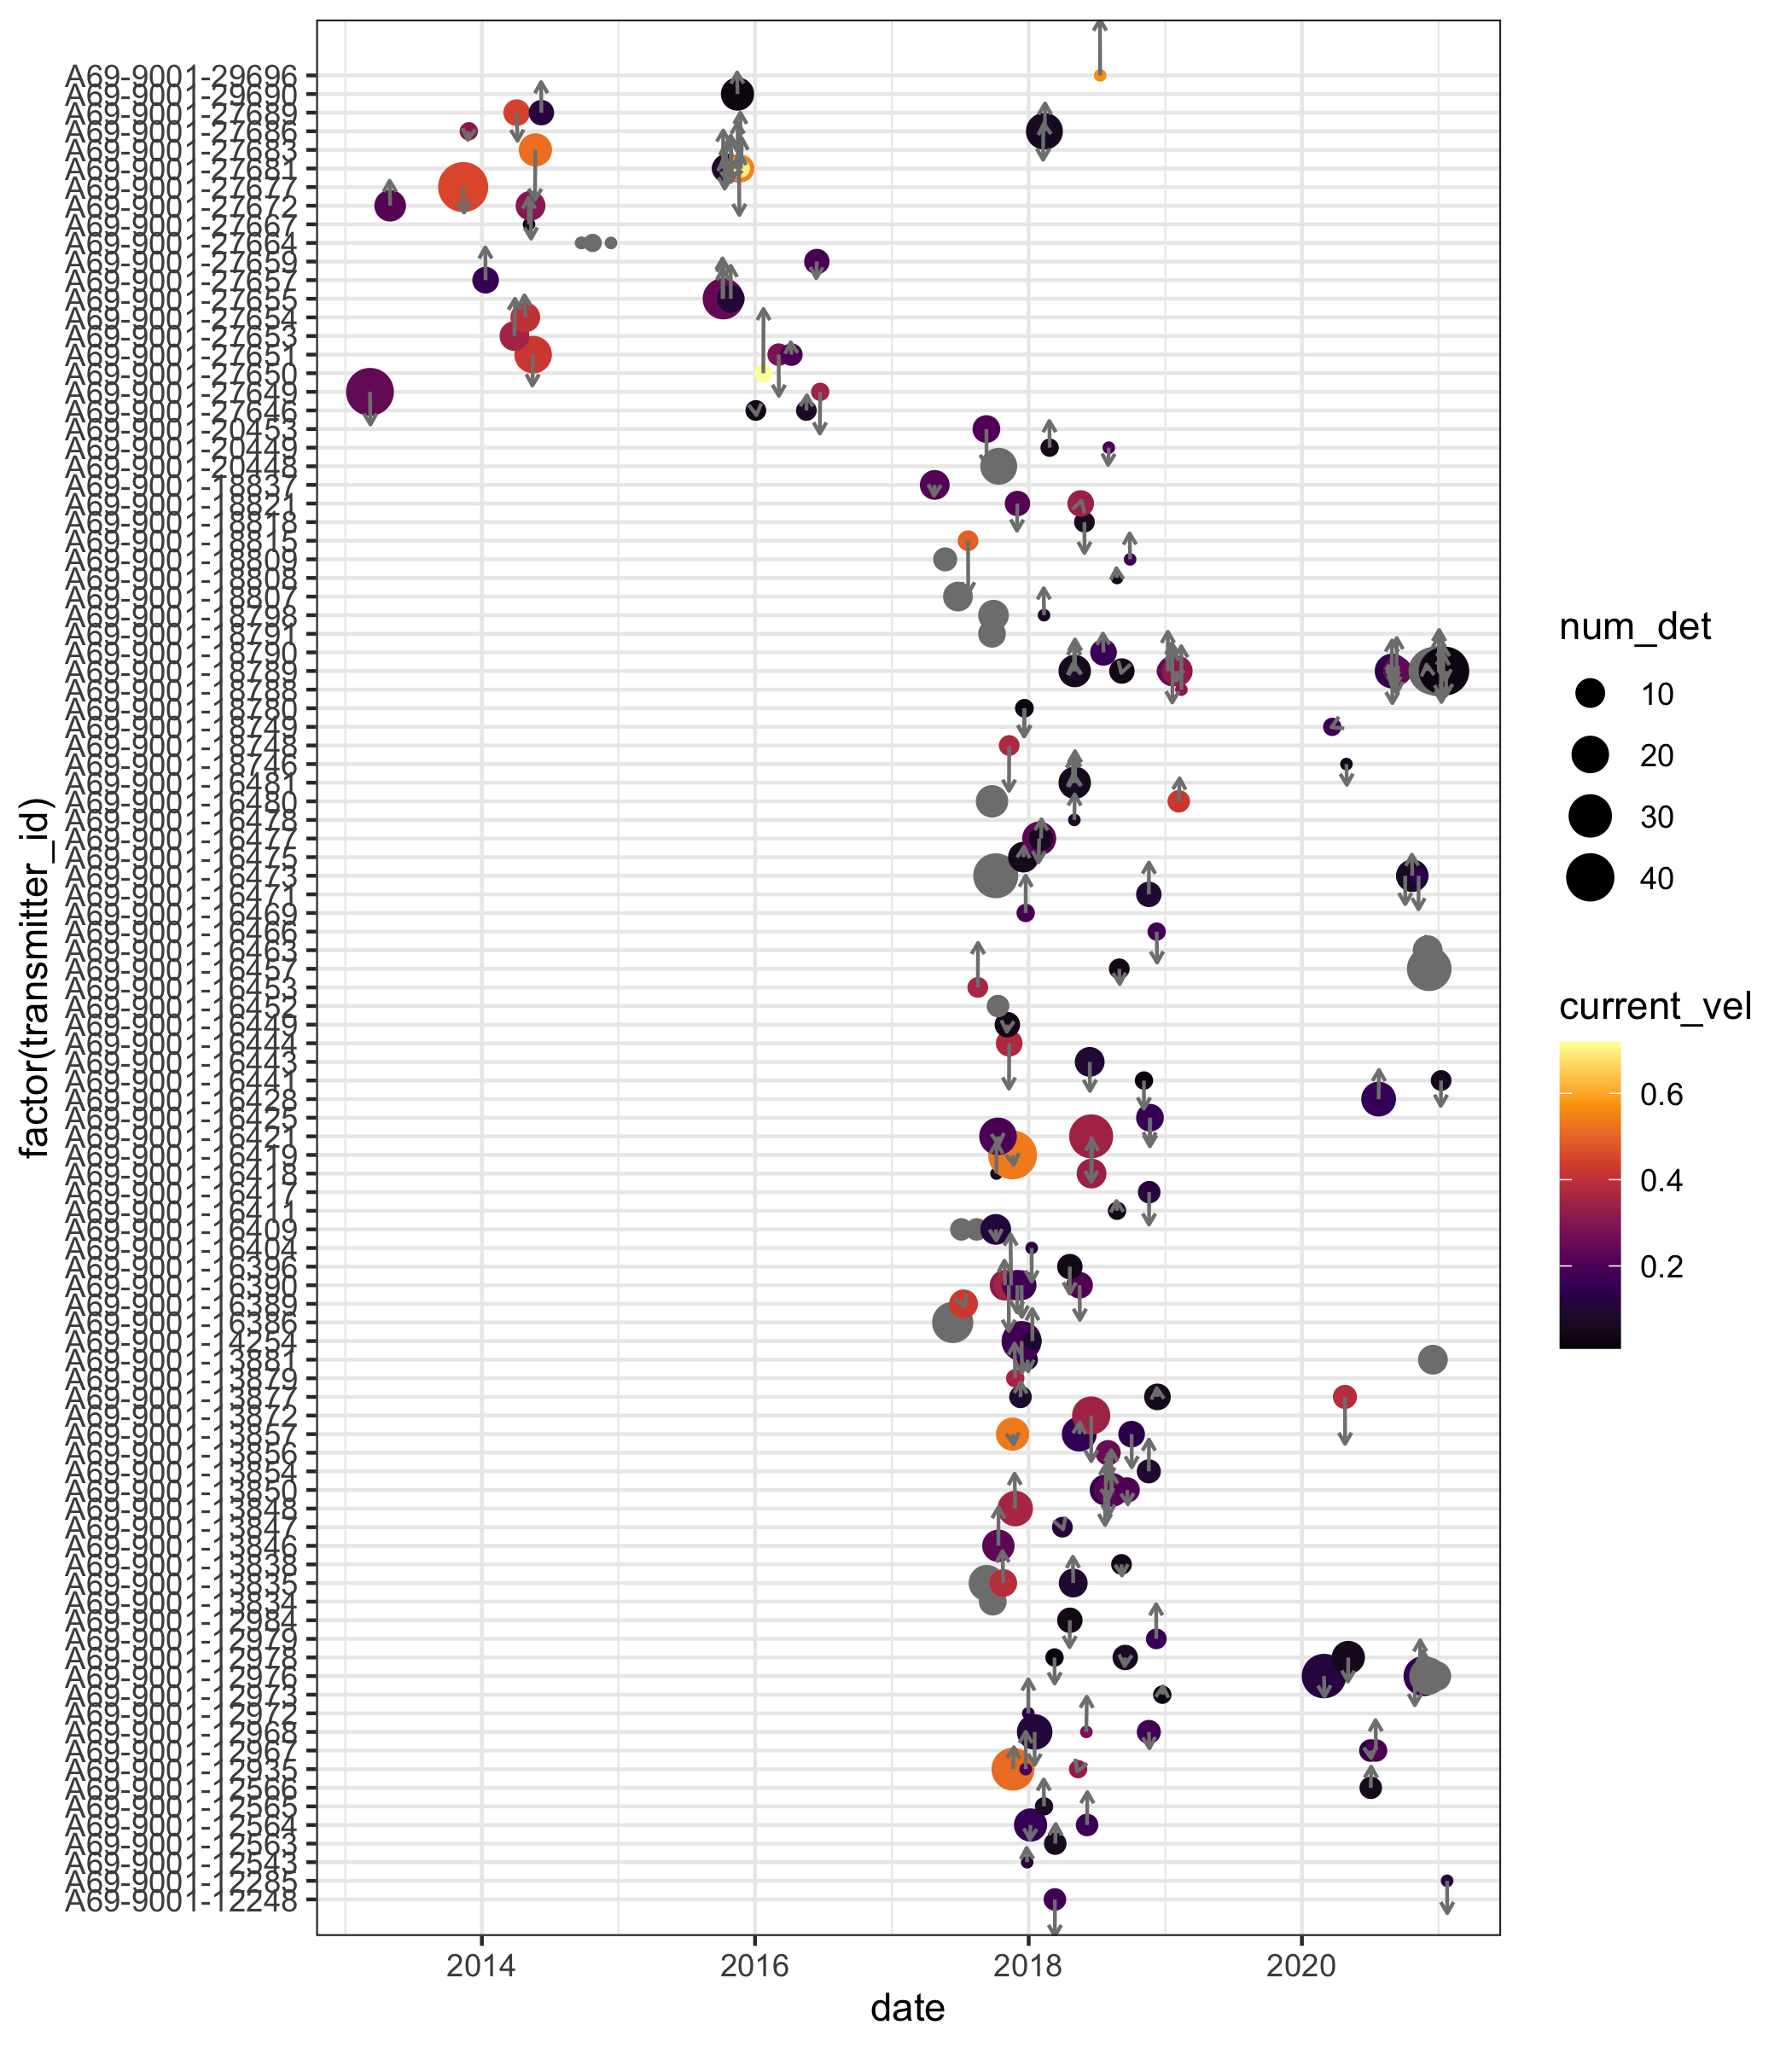
Session 3: Additional Steps
https://imos-animaltracking.github.io/Innovasea-IMOS-Workshop-2022/index.html
Appending environmental data to movement data
REMORA package

